Slide 1

Social Media
Task - 2

Slide 2
Social Media
The development of this project centered on the development of a message protocol that would allow the application to properly log in users, send messages, and perform system maintenance.
LMS USERNAME | NAME | BATCH
2115a24 | P. Sai Krishna | A2
2115a247 | V .Venkata sai | A2
2115a216 | B vinod kumar Reddy | A2
2115a223 | K . Avinash | A2

Slide 3
Task - 2
Create various Front End Programs
Draw and design a uniform front end code for calculator
Draw and design a interactive front end code for text-editor
Evaluation Metric:
100% Completion of the above tasks
Learning Outcome
Get to know about concepts of project bucketing
Knowing about various frontend development framework like angular, vue,react
Know about various react topics like components, props, state, life cycle etc.

Slide 4
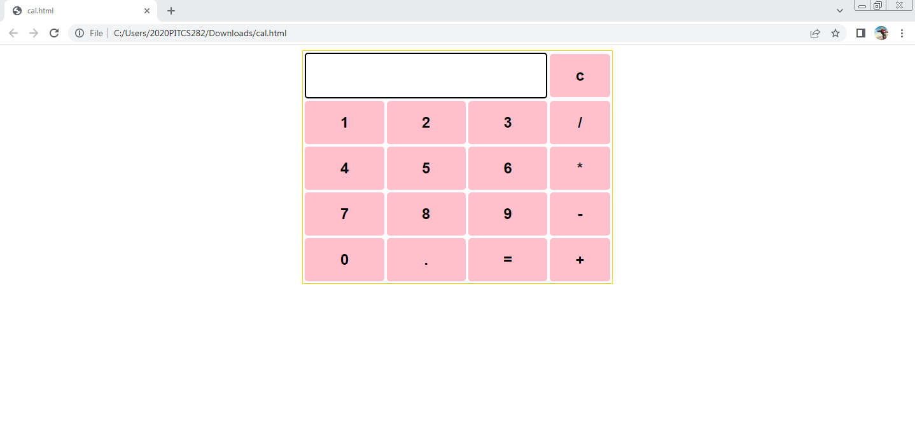
Past calculator output here

Slide 5
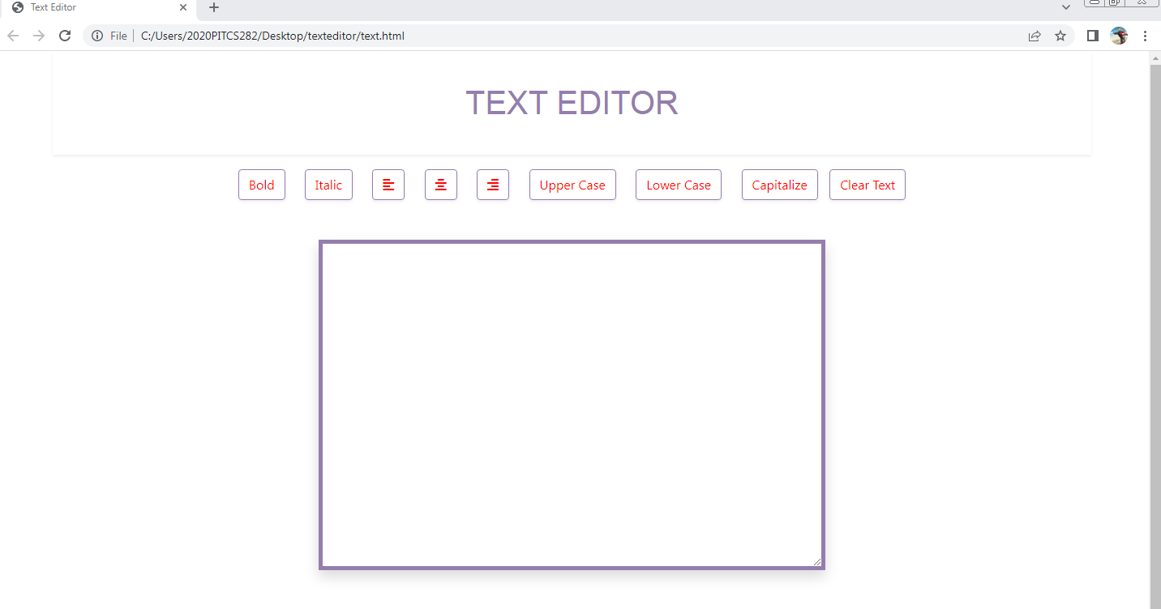
Past text editor output here

Slide 6
Assessment Parameter
Setup Project for Calculator project
Setup basic structure of text-editor project
Create a main component with the outer structure of calculator
Check-List
Create main component with all feature buttons
Create a button component with on click handler
Create a json object to store data for text editor
Create a ` evaluateExpresion` function to evaluate value
Push both code to github

Slide 7
Social Media
https://github.com/Nani181818/social-media.git

